Slide 1
Crime rate Analysis
Rishita Gupta
05601012020
Cse-1

Slide 2
Introduction
Crime is one of the biggest and dominating problem in our society and its prevention is an important. Task.Crimes are of different type – robbery, murder, rape, assault, battery, false imprisonment, kidnapping, homicide. The crime activities have been increased at a faster rate and it is the responsibility of police department to control and reduce the crime activities. Crime prediction and criminal identification are the major problems to the police department as there are tremendous amount of crime data that exist. There is a need of technology through which the case solving could be faster. This require keeping track of all the crimes and maintaining a database for same which may be used for future reference. The current problem faced are maintaining of proper dataset of crime and analysing this data to help in predicting and solving crimes in future.

Slide 3
AIM
The aim of this project is to make crime prediction using the features present in the dataset. The dataset is extracted from the official sites. With the help of machine learning algorithm, using python as core we can predict the type of crime which will occur in a particular area. The objective would be to train a model for prediction. The training would be done using the training data set which will be validated using the test dataset. Building the model will be done using better algorithm depending upon the accuracy. The K-Nearest Neighbour (KNN) classification and other algorithm will be used for crime prediction. Visualization of dataset is done to analyse the crimes which may have occurred in the country.

Slide 4
Problem Statement
We were given a dataset containing the masked data on reported incidents of crime (with the exception of murders where data exists for each victim) that occurred at a place from 2019 to 2021.
Detail of Columns:
Id: Unique identifier (#Primary Key)
Date: Date and time when the incident occurred. Best estimated values.
Crime_Id: This is directly linked to the Primary Type and Description.
Primary Type: The primary description of the Crime_Id.
Description: The secondary description of the Crime_Id, a subcategory of the primary description.
Location_description: Description of the location where the incident occurred.
Arrest: Indicates whether an arrest was made.
Domestic: Indicates whether the incident was domestic-related

Slide 5
Software Required
Tools Used:
Anancond Navigator 1.9.6
Jupyter Notebook 5.7.4
Libraries Used:
Analyzing- Numpy, Pandas, Scikit-Learn
Visualization-Matplotlib, Seaborn

Slide 6
Tasks To do
Exploratory Analysis
What is the type of data you see in the dataset: Continuous or Categorical?
Which month and year had highest crimes
What type of crimes are most common?
Where are different types of crimes most likely to occur?
Which crime has highest arrests
How many domestics assaults are there?
Which fields are important for analysis.
Predictive Analysis
Predict the future rate for crime in the city based on the various categories
Present a technical report on the data, supported with graphs
Crime vs arrest
Crimes per year, per day, per hour
Identify crimes per location
What measures this city police may take to decrease the predicted rate of crime?

Slide 7
Implementation
Explorartory data Analysis
Data Preprocessing
Model Training
Model Evaluation
Data Visualization

Slide 8
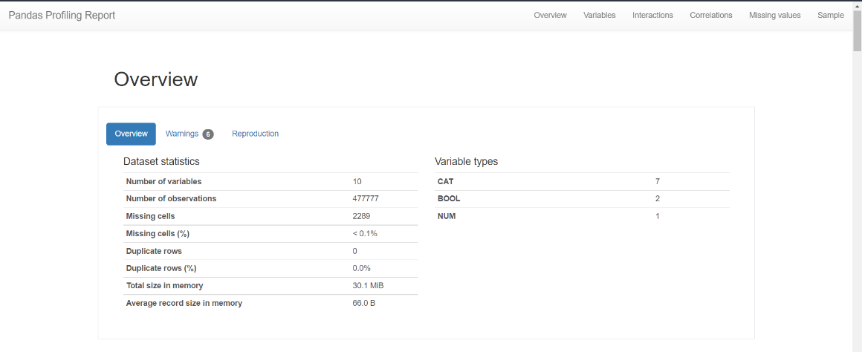
Exploratory Data Analysis
Step 1: Cleaning and analyzing the Dataset (Using ProfileReport Function of Python):

Slide 9
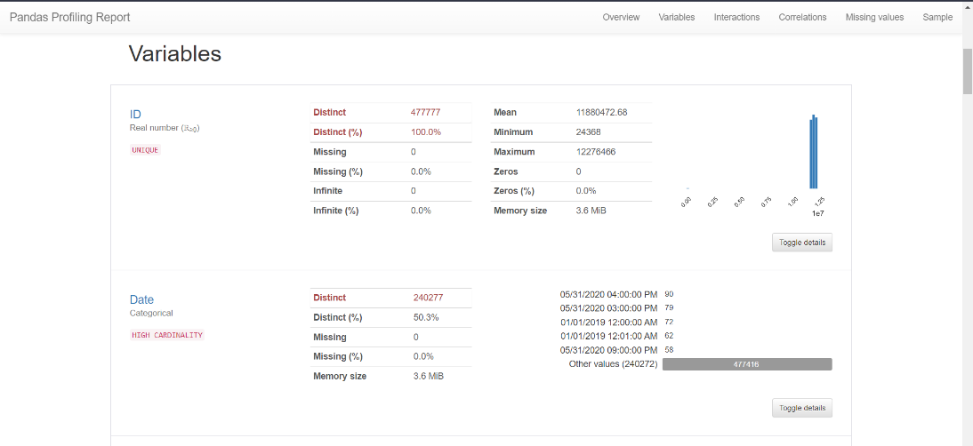

Slide 10
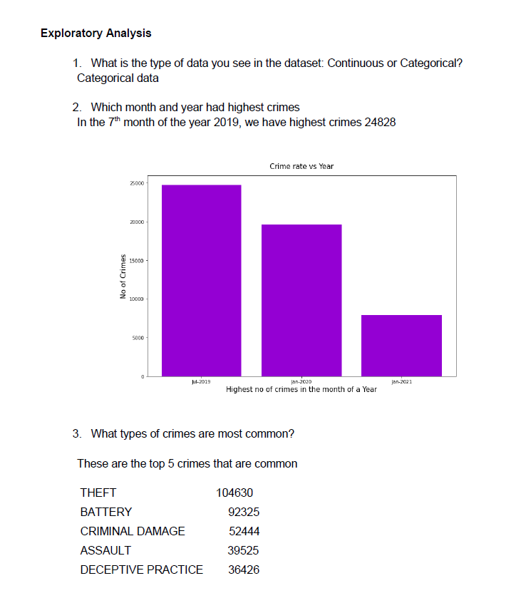
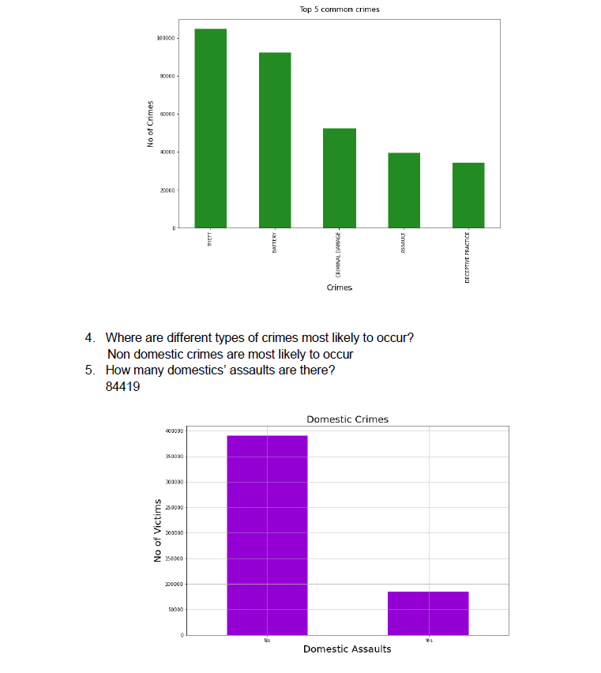
Step 2: Answering the set of questions given to us using Numpy and Pandas libraries

Slide 11
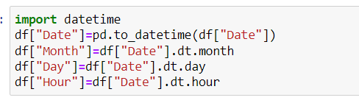
Data Preprocessing
Step 1: Splitting date feature into days, month, years, hours and minutes using the time module of python.

Slide 12

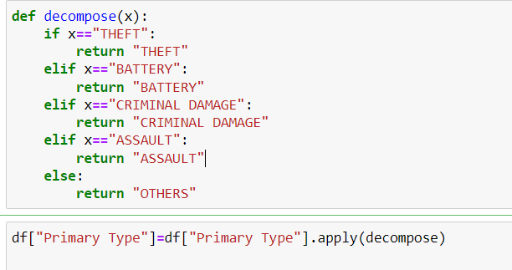
Step 2:Converting Categorical Data into Numerical data using BaseN encoder and Binary Encoder and using the decomposing function as well.

Slide 13
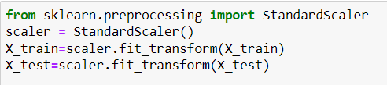
Step 3: Dropping unnecessary columns and selecting important features for fitting in the model.
Step 4:Using Standard Scaler to normalize the dataset.

Slide 14
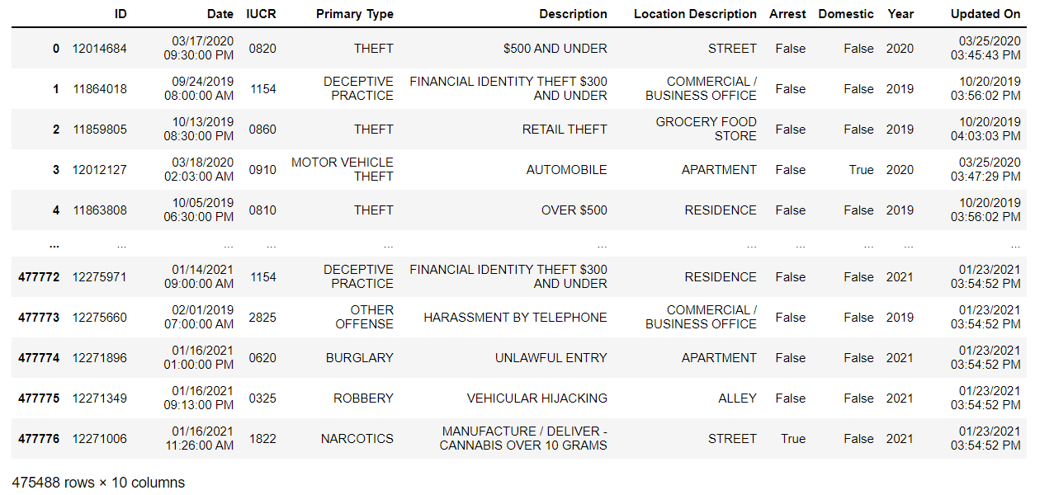
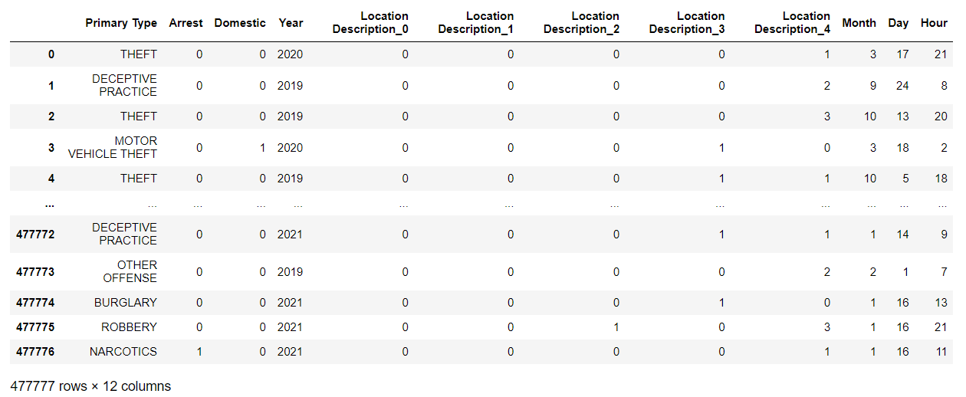
Original Dataset
Dataset After Preprocessing

Slide 15
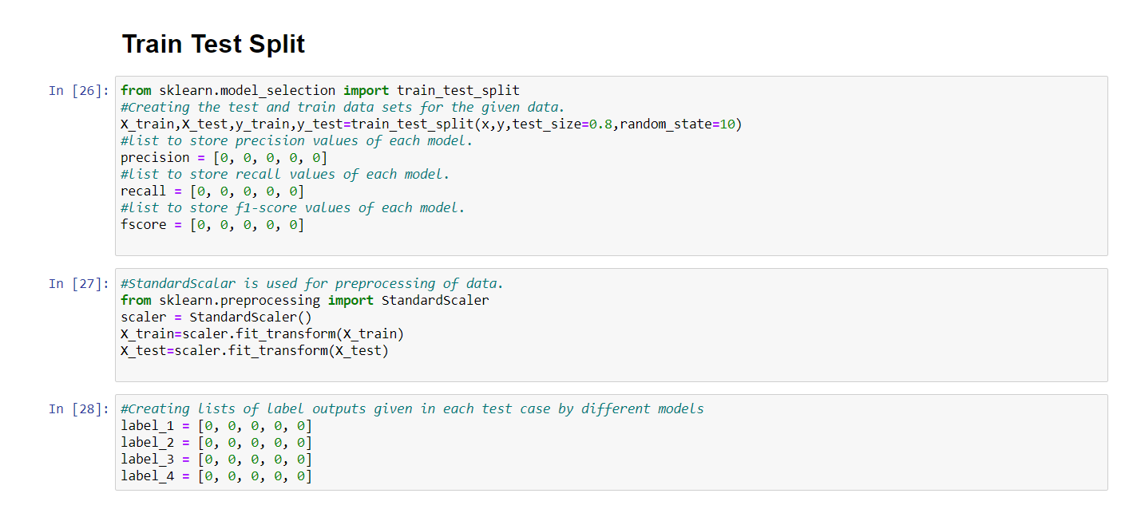
Model Training
Step 1: Splitting the dataset into Training and testing sets

Slide 16
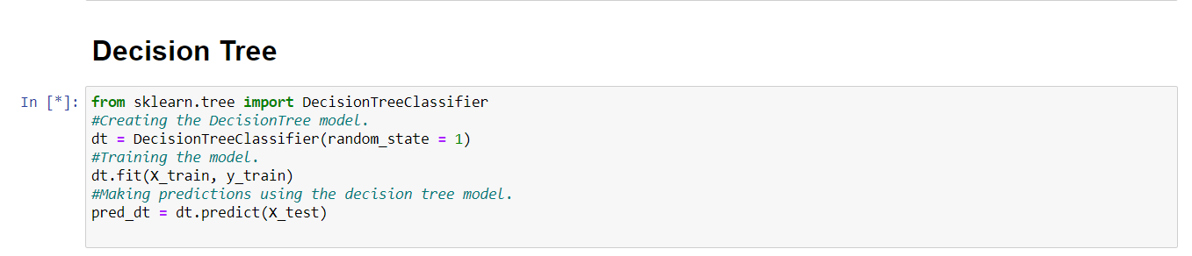
Step 2: Model Selection
a) Decision Tree
Decision tree is the most powerful and popular tool for classification and prediction. A Decision tree is a flowchart like tree structure, where each internal node denotes a test on an attribute, each branch represents an outcome of the test, and each leaf node (terminal node) holds a class label.

Slide 17
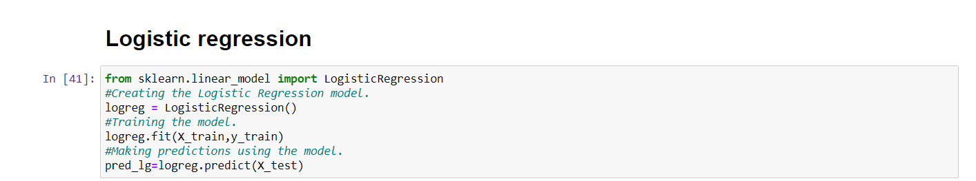
b) Logistic Regression:
Logistic regression is a process of modelling the probability of a discrete outcome given an input variable. It is a useful analysis method for classification problems, where you are trying to determine if a new sample fits best into a category.
It essentially uses a logistic function to model a binary output variable bounded between 0 to 1

Slide 18
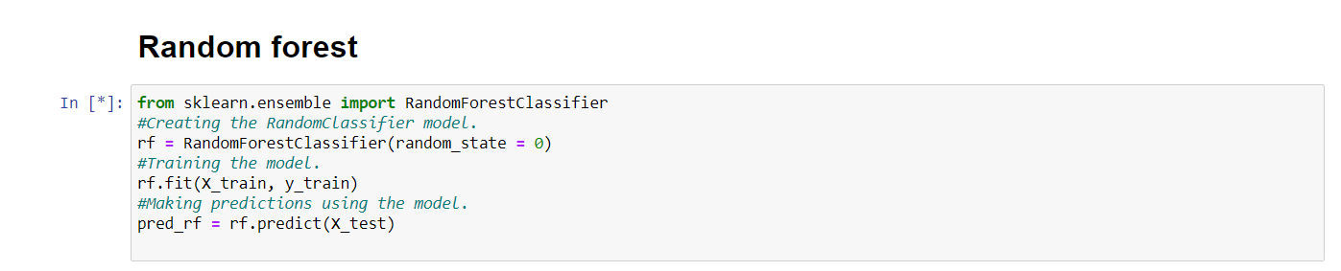
c) Random Forest:
A random forest utilizes ensemble learning, to solve regression and classification problems.A random forest algorithm consists of many decision trees. The ‘forest’ generated by the random forest algorithm is trained through bagging
It eradicates the limitations of a decision tree algorithm. It reduces the overfitting of datasets and increases precision.

Slide 19
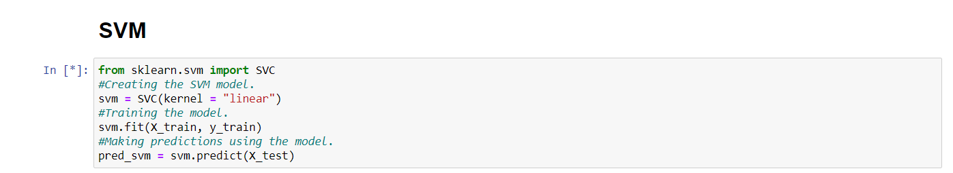
d) SVM(Support Vector Machine):
In the SVM algorithm, we plot each data item as a point in n-dimensional space (where n is a number of features you have) with the value of each feature being the value of a particular coordinate. Then, we perform classification by finding the hyper-plane that differentiates the two classes very well

Slide 20
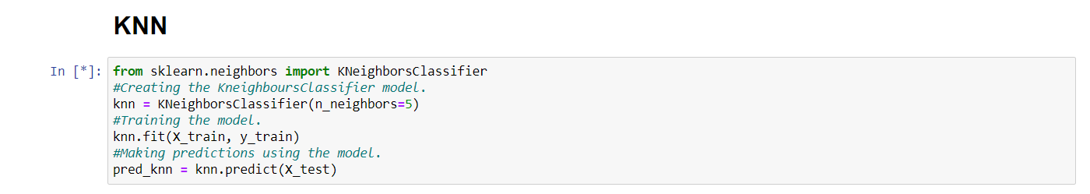
e) KNN( K-Nearest Neighbors): K Nearest Neighbor algorithm falls under the Supervised Learning category and is used for classification (most commonly) and regression. It is a versatile algorithm also used for imputing missing values and resampling datasets. As the name (K Nearest Neighbor) suggests it considers K Nearest Neighbors (Data points) to predict the class or continuous value for the new Datapoint.

Slide 21
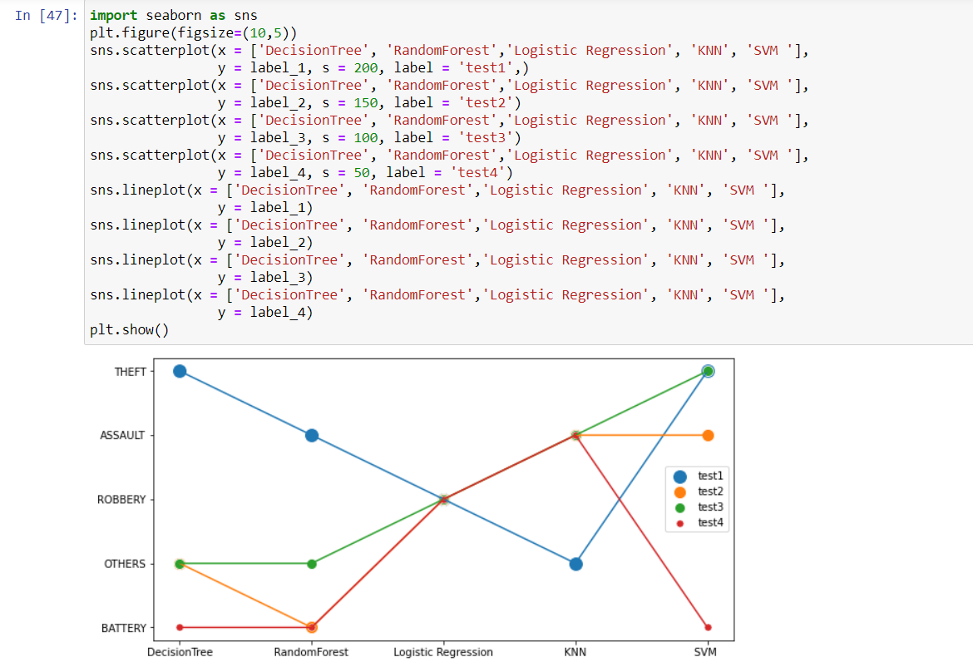
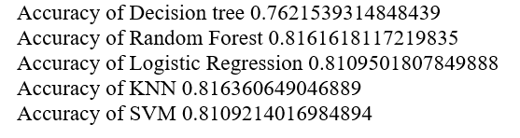
Model Evaluation

Slide 22
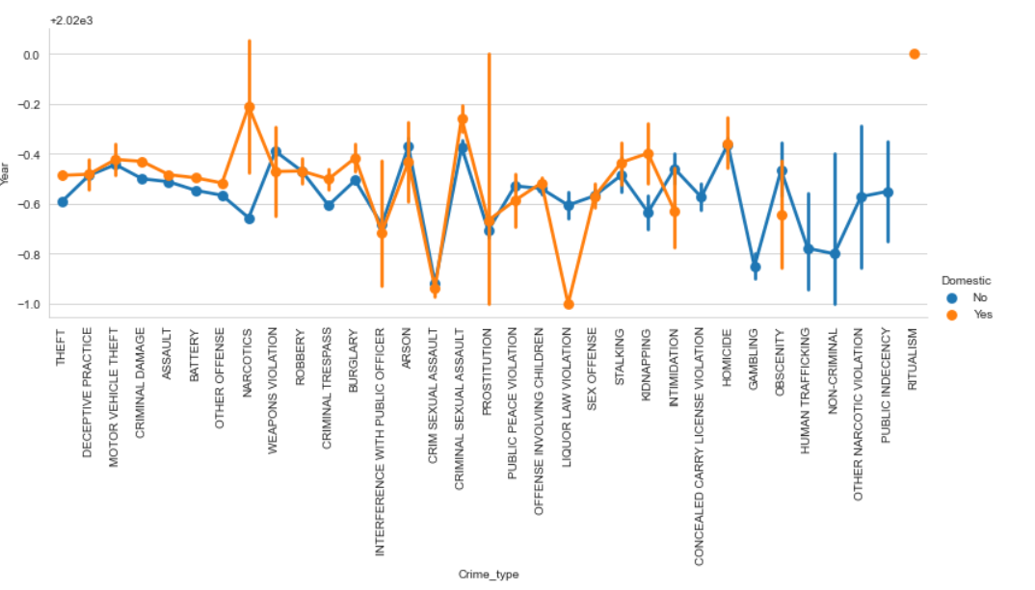
Data Visualization

Slide 23
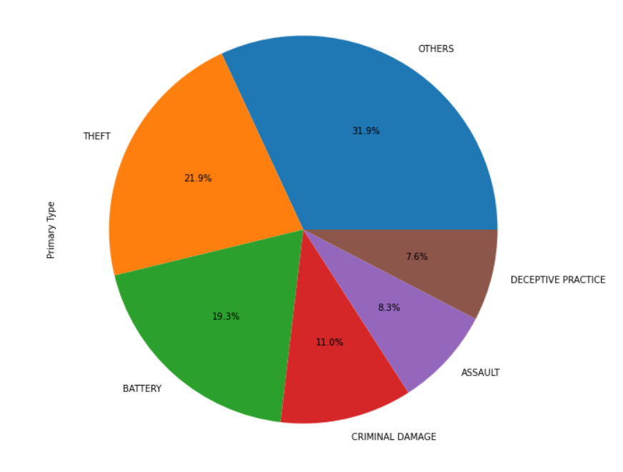
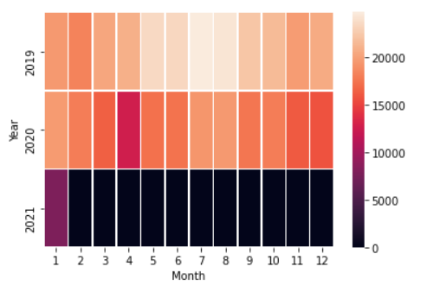
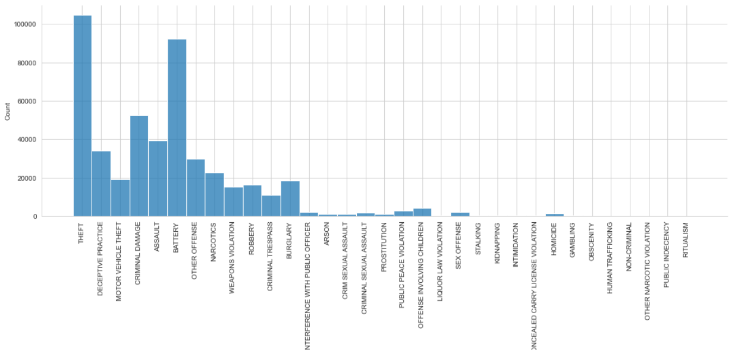
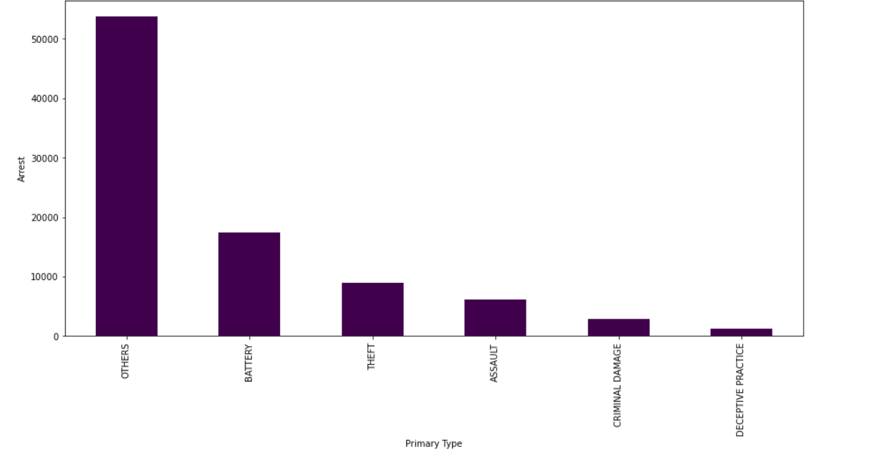

Slide 24
Challenges FAced
It was difficult to get all the members together on the same page and coordination was a bit difficult. Sometimes, the work done by fellow members didn’t sync with the one submitted by another causing disparities. Time management and distribution was also one of the challenges faced.
Less time was left for model development and more time was given to data preprocessing.
Another issue is asymmetrical data: when information in one system does not reflect the changes made in another system, leaving it outdated. It became a crucial step to filter data to avoid such ambiguities.

Slide 25
Conclusion
With the help of machine learning technology, it has become easy to find out relation and patterns among various data. The work in this project mainly revolves around predicting the type of crime which may happen if we know the location of where it has occurred. Using the concept of machine learning we have built a model using training data set that have undergone data cleaning and data transformation. The model predicts the type of crime with accuracy of 0.816. Data visualization helps in analysis of data set. The graphs include bar, pie, line and scatter graphs each having its own characteristics. We generated many graphs and found interesting statistics that helped in understanding crimes datasets that can help in capturing the factors that can help in keeping society safe.

Slide 26
Bibliography
[1] Ashish Sharma, Dinesh Bhuriya, Upendra Singh.
"Survey of Stock Market Prediction Using Machine Learning Approach", ICECA 2017.
[2] Machine Learning in Production: Developing and Optimizing Data Science Workflows and
Applications (Addition-Wesley Data & Analytics)
[3] Python : The Complete Reference - Martin C. Brown
[4] https://docs.anaconda.com/anaconda/install/windows/
[5] Prashant S. Chavan, Prof. Dr. Shrishail. T. Patil ―Parameters for Stock Market Prediction,‖ Prashant S Chavan et al, Int.J.Computer Technology & Applications, Vol 4 (2),337-340.
[6] Machine learning course from udemy

